Slide 1
IMPACT DISSEMINARION
Strengthening innovative social
entrepreneurship practices for disruptive business settings in Thailand and Myanmar
Projectref.: 609711-EPP-1-2019-1-AT-EPPKA2-CBHE-JP
Duration: 36 Months (15/01/2020-14/01/2023)
Erasmus+ Capacity Building in Higher Education

Slide 2
Cause related marketing
Builds brand awareness
Enhances brand image
Elicits brand engagement
Establishes brand credibility
Creates brand community
Evokes brand feelings
Notes:
A successful cause-marketing program can improve social welfare, create differentiated brand positioning, build strong consumer bonds, enhance the company’s public image, create a reservoir of goodwill, boost internal morale and galvanize employees, drive sales, and increase the firm’s market value. Consumers may develop a strong, unique bond with the firm that transcends normal marketplace transactions.

Slide 3
Cause related marketing
Align focus area with your mission
Develop cross-functional strategy team
Choose partners carefully
Communicate through variuos channels
Go local
Innovate

Slide 4
Social marketing
COGNITIVE CAMPAIGNS - demonstrate, explain (eg. the importance of social innovation)
ACTION CAMPAIGNS - attract, motivate, inspire (to vaccinate, to vote etc.)
BEHAVIORAL CAMPAIGNS - demotivate bad behaviors (eg. demitivate to smoke cigarettes)
VALUE CAMPAIGNS - change attitudes
Notes:
Choosing the right goal or objective for a social marketing program is critical. Should a family-planning campaign focus on abstinence or birth control? Should a campaign to fight air pollution focus on ride sharing or mass transit?

Slide 5
Planninng is very important!
Choose target stakeholders ready to respond
Promote doable behavior in simple terms
Explain the benefits of engaging in the Hub
Make it easy to adopt the behavior
Develop attention-grabbing messages
Use education-entertainment approach
Notes:
While social marketing uses a number of different tactics to achieve its goals, the planning process follows many of the same steps as for traditional products and services

Slide 6
Planninng is very important!
For effective dissemination, you must identify:
who can benefit from your knowledge (audience)
what you want them to know (message)
how you can reach them (method).

Slide 7
Who is in your audience?
• Who will benefit from the knowledge you have to share?
• Who can take your information and put it into action?
• Think beyond your immediate network!

Slide 8
How do you connect?
• Where do your audience get their information?
• What channels do you have experience in (email, newsletter, blog, notice board, social media)?
• What wider networks are available to you
(special interest groups/ regional groups)?

Slide 9
How should the message look like?
• Agree on your core message and keep your word choice consistent
• Make it attractive and recognisable: colours, fonts, logos, images
• Develop guidelines for colleagues/participants

Slide 11
Marketing communication mix
Advertising
Events and experiences
Public relations and publicity
Mobile marketing
Online and social media marketing
Direct and database marketing
Personal “selling” - ambassadors
Notes:
The marketing communications mix consists of eight major modes of communication:
1. Advertising—Any paid form of nonpersonal presentation and promotion of ideas, goods, or services by an identified sponsor via print media (newspapers and magazines), broadcast media (radio and television), network media (telephone, cable, satellite, wireless), electronic media (audiotape, videotape, videodisk, CD-ROM, Web page), and display media (billboards, signs, posters).
2. Sales promotion—A variety of short-term incentives to encourage trial or purchase of a product or service including consumer promotions (such as samples, coupons, and premiums), trade promotions (such as advertising and display allowances), and business and sales force promotions (contests for sales reps).
3. Events and experiences—Company-sponsored activities and programs designed to create daily or special brand-related interactions with consumers, including sports, arts, entertainment, and cause events as well as less formal activities.
4. Public relations and publicity—A variety of programs directed internally to employees of the company or externally to consumers, other firms, the government, and media to promote or protect a company’s image or its individual product communications.
5. Online and social media marketing—Online activities and programs designed to engage customers or prospects and directly or indirectly raise awareness, improve image, or elicit sales of products and services.
6. Mobile marketing—A special form of online marketing that places communications on consumer’s cell phones, smart phones, or tablets.
7. Direct and database marketing—Use of mail, telephone, fax, e-mail, or Internet to communicate directly with or solicit response or dialogue from specific customers and prospects.
8. Personal selling—Face-to-face interaction with one or more prospective purchasers for the purpose of making presentations, answering questions, and procuring orders.

Slide 12
Marketing communication mix - tips
Social media is for conversation, not just announcements - engage discussions
Choose 2‐3 platforms max; interact often
Recruit participants to join in
Facebook ‐ make a page not a profile!

Slide 13
Micromodel of stakeholder response
With an ideal ad campaign:
The right person is exposed to the message at the right place and time
The ad causes the person to pay attention
The ad reflects person’s level of understanding of the hub
The ad motivates to consider engaging
The ad creates strong brand associations
Notes:
To increase the odds of success for a communications campaign, marketers must attempt to increase the likelihood that each step occurs. The challenges in achieving success with communications necessitate careful planning.

Slide 14
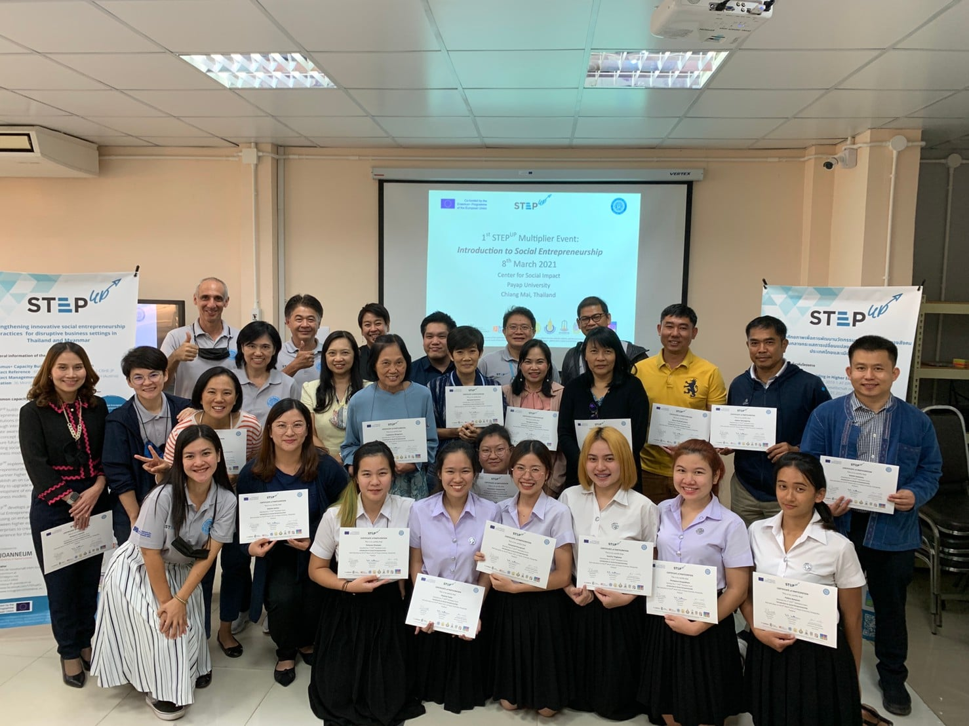
Photos
Get consent of every person on the photo
Challenge stereotypes
Shoot in high quality
Use authentic situations
Make it attractive!

Slide 15
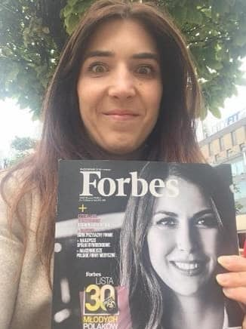
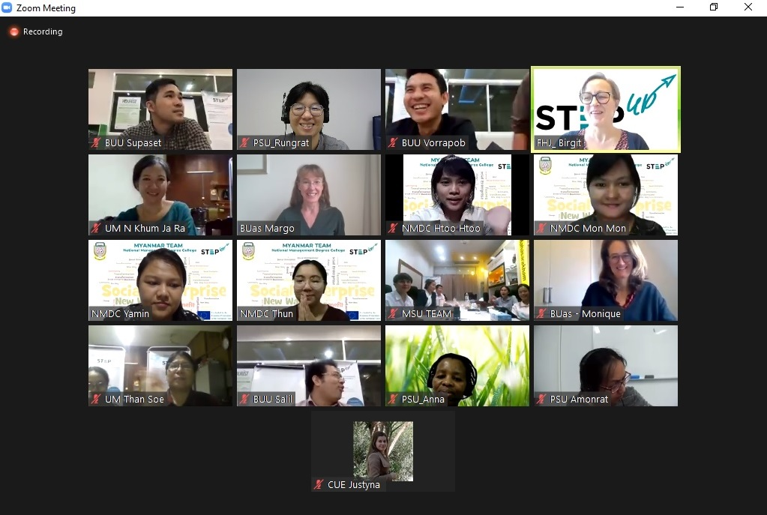

Slide 16
Credit Erasmus+
Your funding comes from the European Union through Erasmus+
Because this is public money, and to let others know of the opportunity, you must credit Erasmus+ in information about the hub
Use Erasmus + logo
Write: “(Co‐)funded by the Erasmus+ programme of the European Union”

Slide 17
Source: Pearson Education Ltd. (2016)

Slide 18
http://scalingpathways.globalinnovationexchange.org/
http://www.ensie.org/
https://esela.eu/
http://www.socialeconomy.pl/
http://www.gsen.global/
http://euclidnetwork.eu/
http://socialinnovation.lv/en/european-social-franchising-network/
https://www.springimpact.org/
Kotler, P., Keller, K. (2016). Marketing Management. London: Pearson Education Limited.
Kotabe, M., Helsen, K. (2017). Global Marketing Management (7th Edition). Wiley
Benkenstein, M. & Uhrich, S. (2010). Strategisches Marketing: Ein wettbewerbsorientierter Ansatz (3. Auflage). Stuttgart: Kohlhammer
Interesting links & books
03

Slide 19
Erasmus+ Capacity Building in Higher Education
Strengthening innovative social
entrepreneurship practices for disruptive business settings in Thailand and Myanmar
Projectref.: 609711-EPP-1-2019-1-AT-EPPKA2-CBHE-JP
Duration: 36 Months (15/01/2020-14/01/2023)

